Slide 1
Factory Pattern

Slide 2
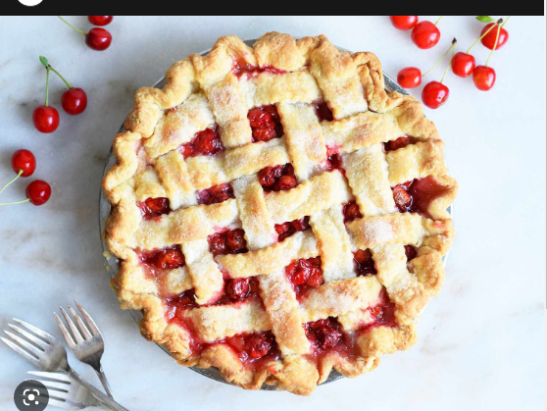
OOPs A PIE
Stands for: A - abstraction
P - polymorphism
I - inheritance
E - encapsulation

Slide 3

Factory Pattern is a Design Pattern

Slide 4
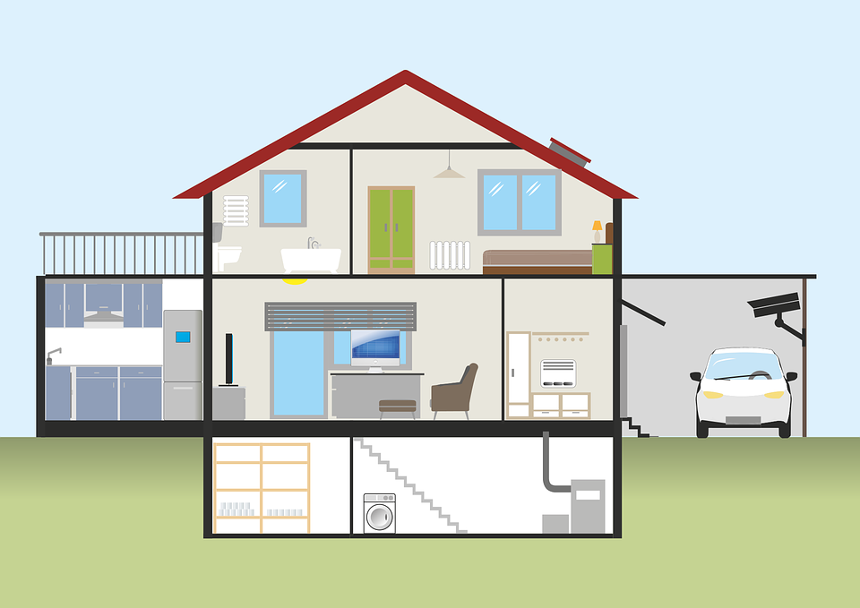
Just like houses have design patterns, programs have patterns too

Slide 5
Pick Design Pattern based on your needs
Ex. Small lot, need stairs for more room

Slide 6
Pick a Design for your Coding Needs

Slide 7
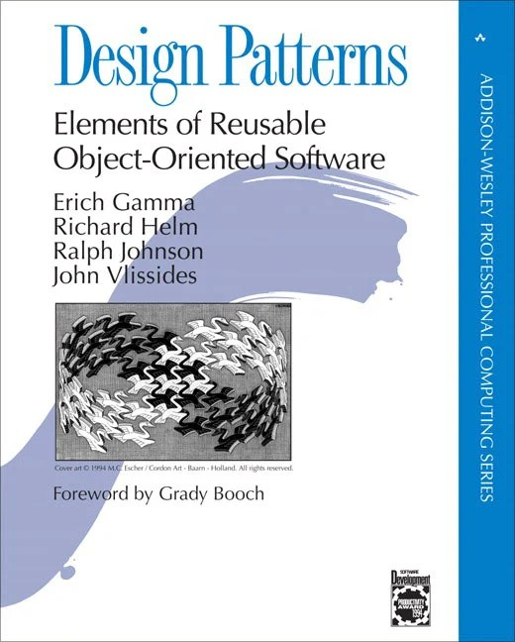
Factory Design Pattern is one of the 23 design
patterns developed by the Gang of Four.

Slide 8
Types of Patterns
Creational Design Patterns
Structural Design Patterns
Behavioral Design Patterns

Slide 9
Types of Patterns
Creational Design Patterns
Structural Design Patterns
Behavioral Design Patterns

Slide 10
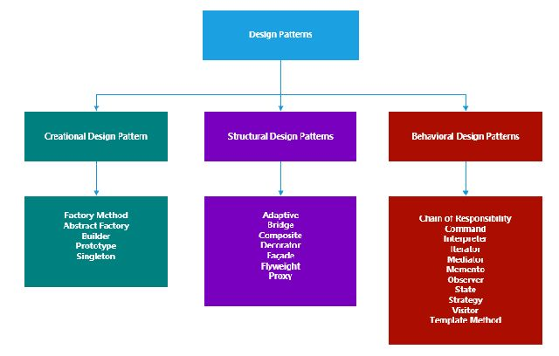
Types of Patterns

Slide 11

Factory

Slide 12
Factory
Place where you make something

Slide 13
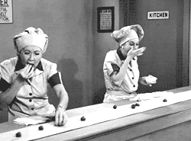
Factory Pattern is a Pattern to Create Objects

Slide 14
Factory Pattern is a Pattern to Create Instances

Slide 15

Factory Pattern - Why we use it
Keep your code DRY!
Dry - Don’t Repeat Yourself

Slide 16

Factory Pattern - Why we use it
When you repeat yourself in code you are creating brittle code or “easily broken code”.

Slide 17



Factory Pattern - Why we use it
Centralized Object Creation: Factory Pattern prevents having to make numerous changes across your application, which is not only a bad practice but will cause many headaches down the line.

Slide 18

Factory Pattern - Why we use it
Not repeating yourself also makes your code more readable; in 6 months or a year you will be able to come right back into the code and see what is happening very easily.

Slide 19

Factory Pattern - Why we use it
Centralized Object Creation
Dynamic Instantiation
Allows our program to be “loosely coupled”
See link:
oop - What is the difference between loose coupling and tight coupling in the object oriented paradigm? - Stack Overflow

Slide 20
Loosely Coupled
In the image, the hat and the body are connected in a way that allows for easy separation. This represents "loose coupling," meaning the hat can be removed without affecting the person. This concept is explained further below.
Consider your skin, which adheres closely to your body, almost like a second glove. Now, imagine wanting to alter your skin color. The process of removing, dyeing, and reattaching the skin illustrates the challenges due to its tight integration with the body. This is an example of "tight coupling," where modifications are complex and require significant alterations to the underlying structure.

Slide 21

Factory Pattern - Why we use it
Bottom line: Provides flexibility, readability, and it provides easily maintainable code

Slide 22
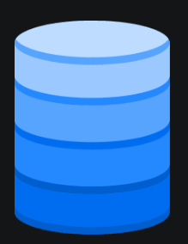
Scenario
Database Connection Management for Different Databases
You're building an application that needs to connect to multiple types of databases like SQL Server, Oracle, MySQL, or others. The connection for each database differs, but we don’t want to make major changes to the core logic.
If you were to hard-code database connection everywhere in your application, it would become tightly coupled to that specific database.

Slide 23

Solution
Factory Pattern!
Create a factory!
At runtime, the correct database connection logic will execute.
The core logic will remain independent.

Slide 24
Factory Pattern - Concept
The Factory Design Pattern - allows one class to create new objects.

Slide 25
Factory Pattern - Concept
Encapsulate the object creation process → you have one location to make changes to the way objects are instantiated.

Slide 26
Factory Pattern - Concept
Can accomplish Factory Pattern using:
1. Interface
OR
2. Abstract Class

Slide 27
Factory Pattern - Concept
Can accomplish Factory Pattern using:
1. Interface
OR
2. Abstract Class
We will use an interface!

Slide 28



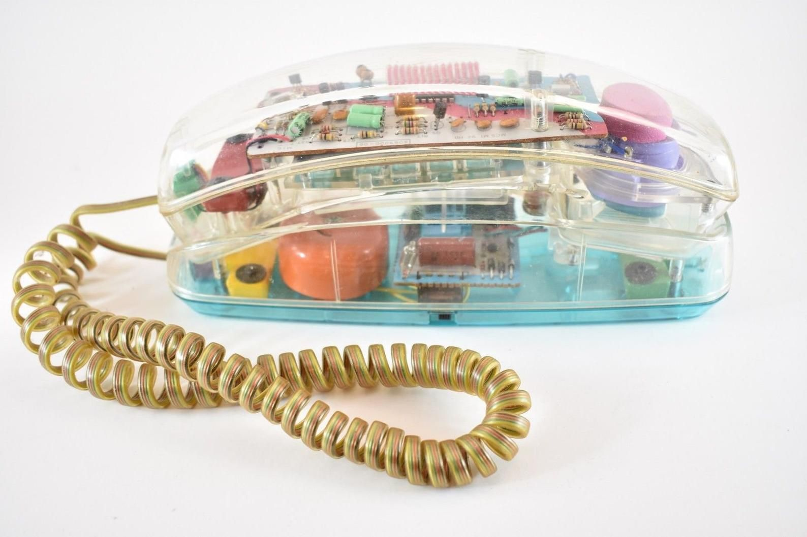
Factory Pattern - Use Case
Making Phones - User chooses which one they want
Apple Android Samsung “Vintage”

Slide 29
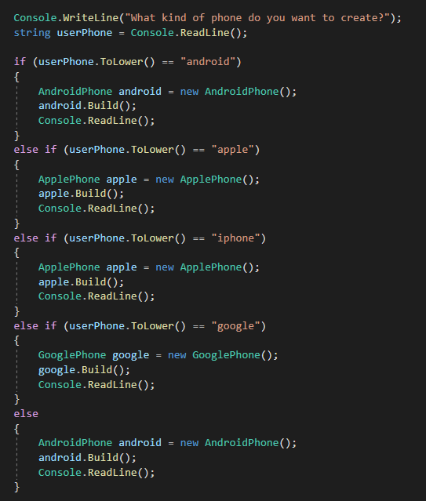
I

Slide 30
I

Slide 31
Factory Pattern - Use Case
Anytime we need to make a change to the way apple phones are created we will need to make that change multiple times. That is NOT an efficient coding practice!
Apple Android Samsung “Vintage”

Slide 32
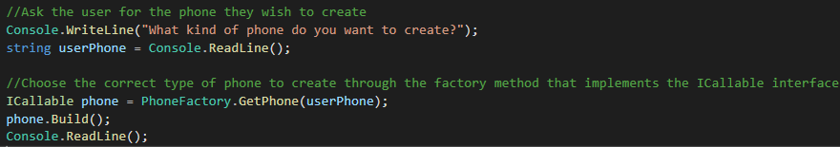

Slide 33
All comes down to methods

Slide 34
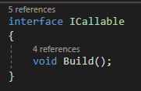
Factory Pattern - How to get started
Create interface

Slide 35
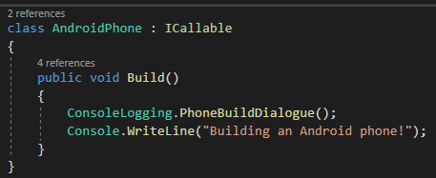
Factory Pattern - How to get started
2. Create classes that conform to interface

Slide 36
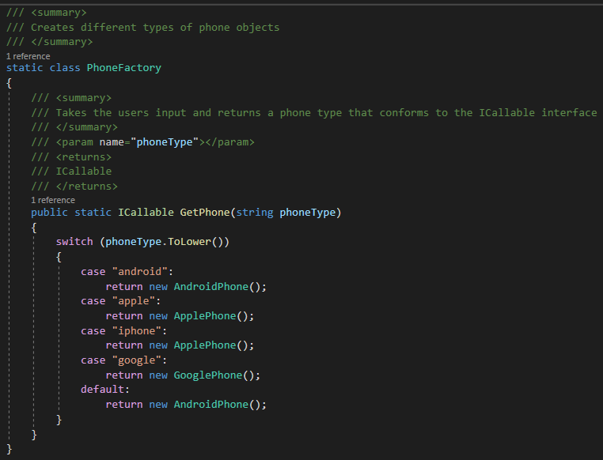
Factory Pattern - How to get started
3. Create Factory

Slide 37
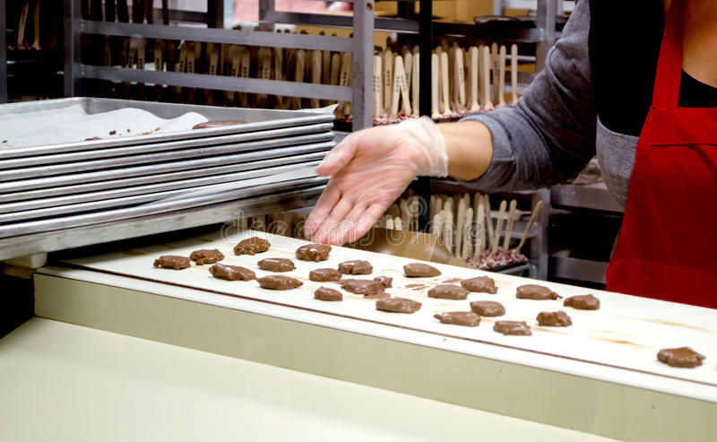
Takeaways:
The Factory Design Pattern is a programming concept that allows one class, separate to the main program or “client”, to create new objects.
By using the factory pattern to encapsulate object creation, you have one location to make changes to the way objects are instantiated

Slide 38

3 Steps to Start
Create interface
Create Classes that conform to interface
Create Factory

